Slide 1


DEEP2NEURON TECH ACADEMY
INTERNSHIP-2023
CNN
DHIVYA R G

Slide 2

Contents
Deep Learning
Neural Networks
CNN - Introduction, Working,
applications
RNN – Introduction, Working,
applications
LSTM – Introduction, Working,
applications
LSTM vs RNN

Slide 3



DEEP LEARNING
Type of machine learning and artificial intelligence (AI)
Imitates the way humans gain certain types of knowledge
Includes statistics and predictive modeling

Slide 4
NEURAL NETWORK
Computing systems with interconnected nodes
Series of algorithms
Endeavors to recognize underlying relationships in a set of data
Mimics the way the human brain operates
Refer to systems of neurons, organic or artificial in nature
Can recognize hidden patterns and correlations in raw data, cluster and classify

Slide 5

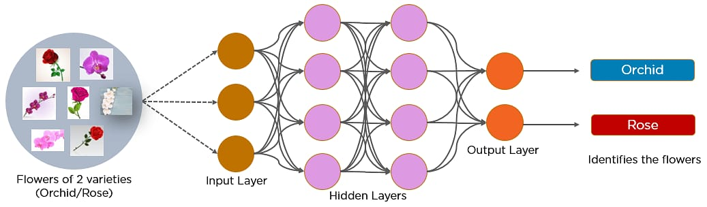
CONVOLUTIONAL NEURAL NETWORKS
A convolutional neural network is a feed-forward neural network
Analyze visual images by processing data with grid-like topology.
Used to detect and classify objects in an image.

Slide 6
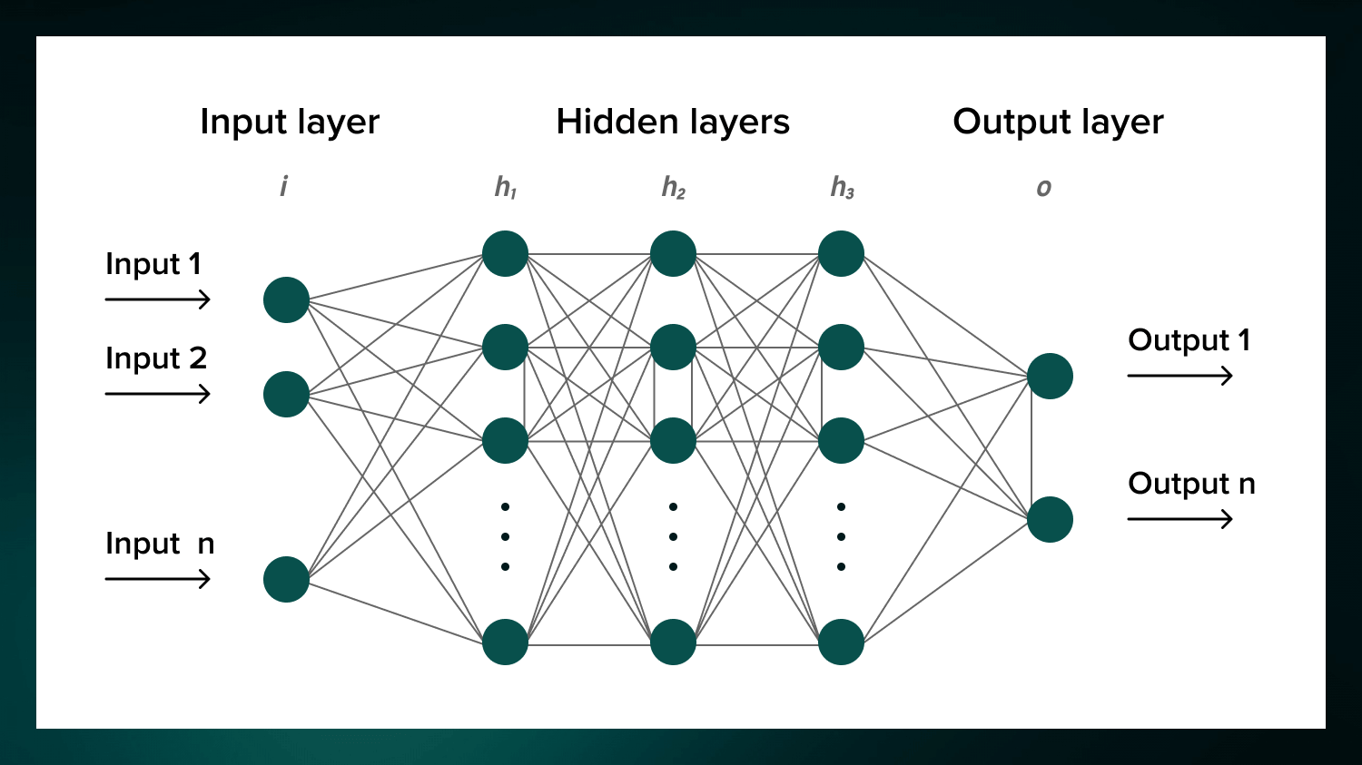
RECOGNITION OF IMAGES - CNN

Slide 7
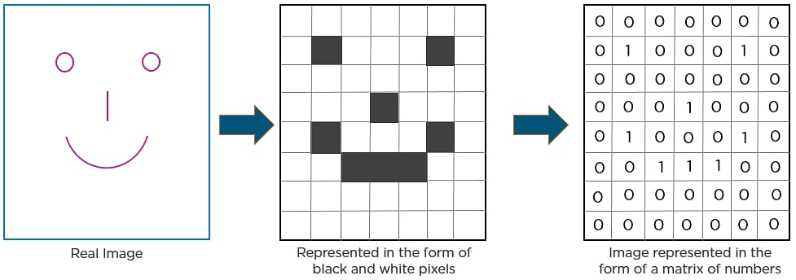
In CNN, every image is represented in the form of an array of pixel
values.

Slide 8
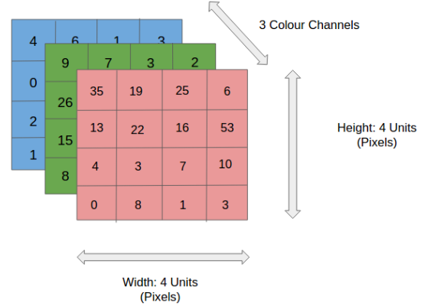
If the image is RGB, then filter will have height x width x 3 dimension

Slide 9

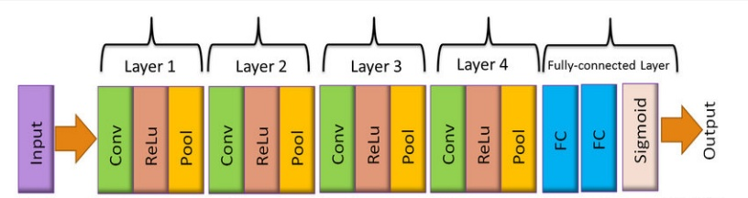
LAYERS OF CNN
Convolutional layer
Relu layer
Pooling layer
Fully Connected layer laye layer

Slide 10
CONVOLUTIONAL LAYER
First step in the process of extracting valuable features from an image.
Contains several filters that perform the convolution operation.
Every image is considered as a matrix of pixel values.

Slide 11
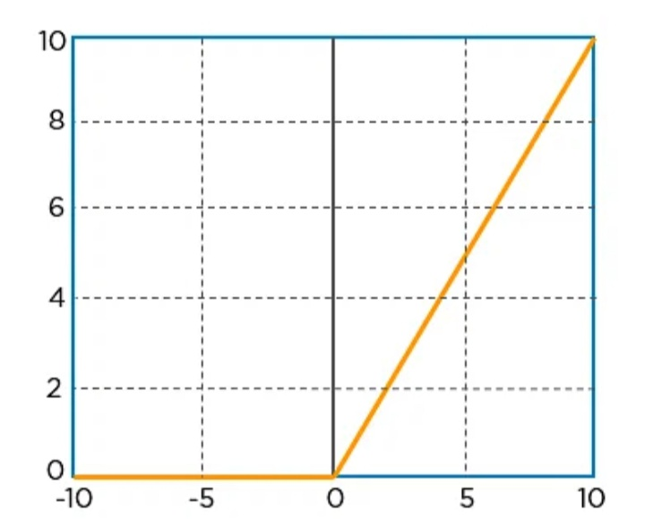

ReLu Layer
Rectified linear unit.
Performs an element-wise operation and sets all the negative pixels to 0.
It introduces non-linearity to the network, generated output is a rectified feature map.

Slide 12
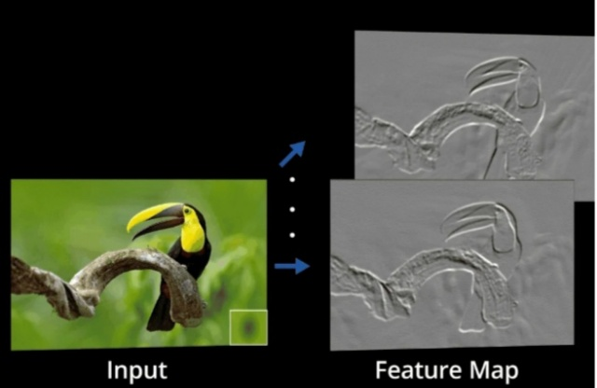

Slide 13
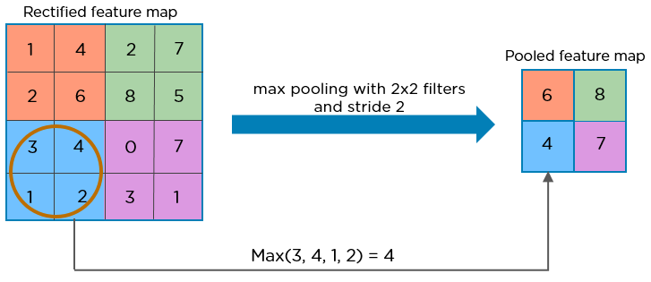
POOLING LAYER
Down-sampling operation that reduces the dimensionality of the feature map.
The rectified feature map goes through a pooling layer to generate a pooled feature map.

Slide 14
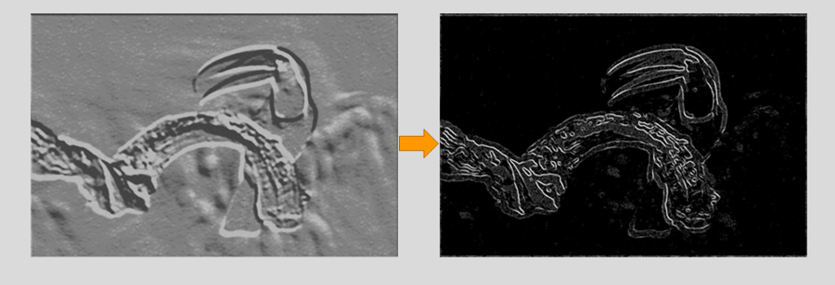
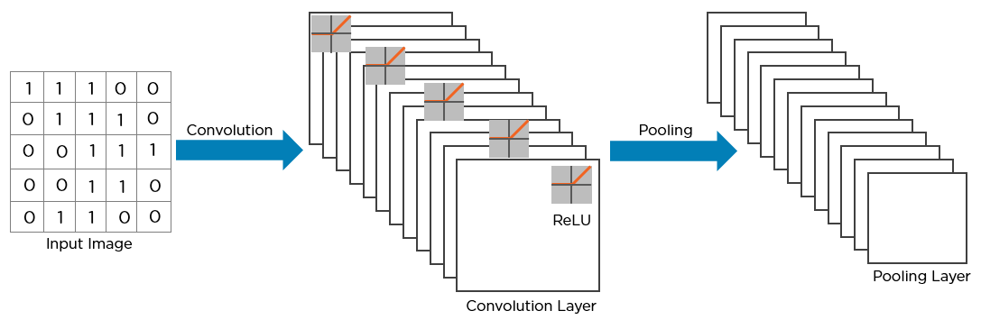

Slide 15
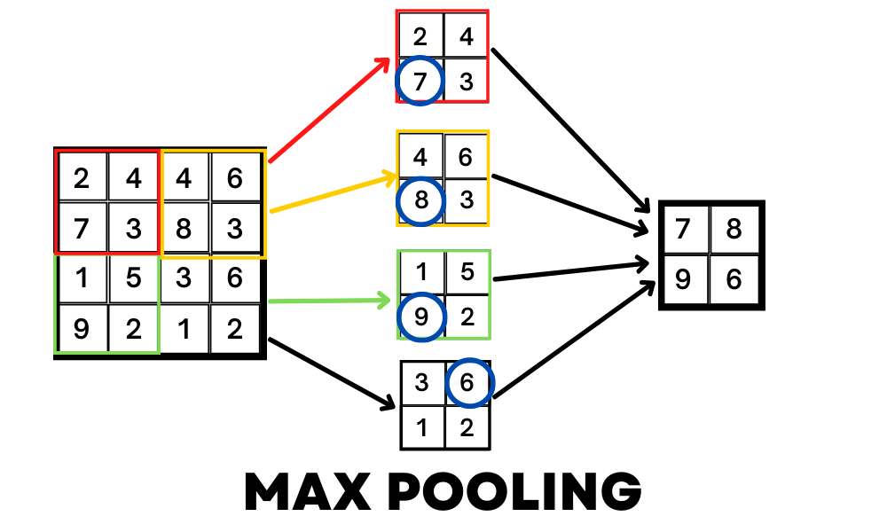

Slide 16
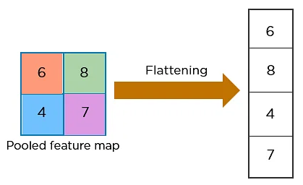
FLATTENING LAYER
Convert the resultant 2-Dimensional arrays from pooled feature maps into a single long continuous linear vector.

Slide 17
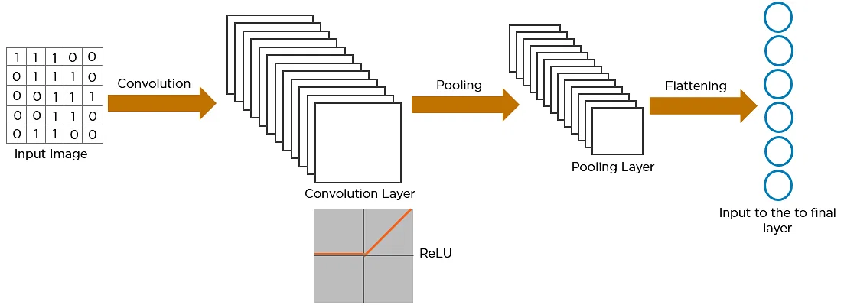

Slide 18
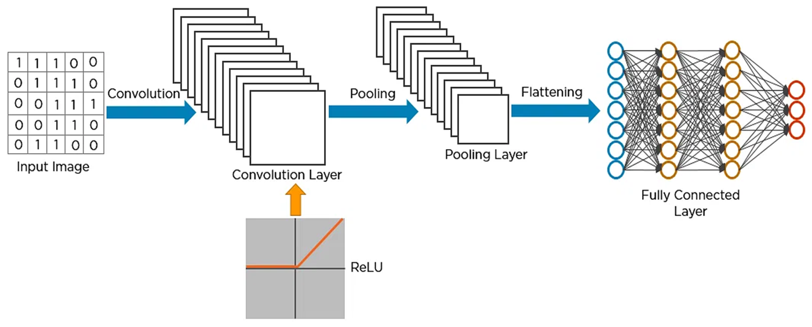
FULLY CONNECTED LAYER
Convolutional Layer + Pooling Layer + input of flattening layer = block in the CNN.
Increased for capturing finer details .

Slide 19
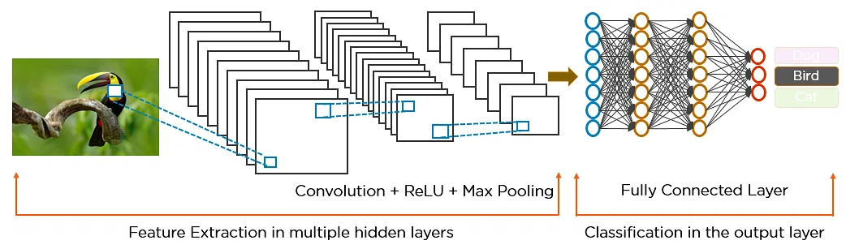
WORKING OF CNN
Local connectivity
Spatial Arrangement
Depth
Stride
Zero Padding
Parameter Sharing

Slide 20
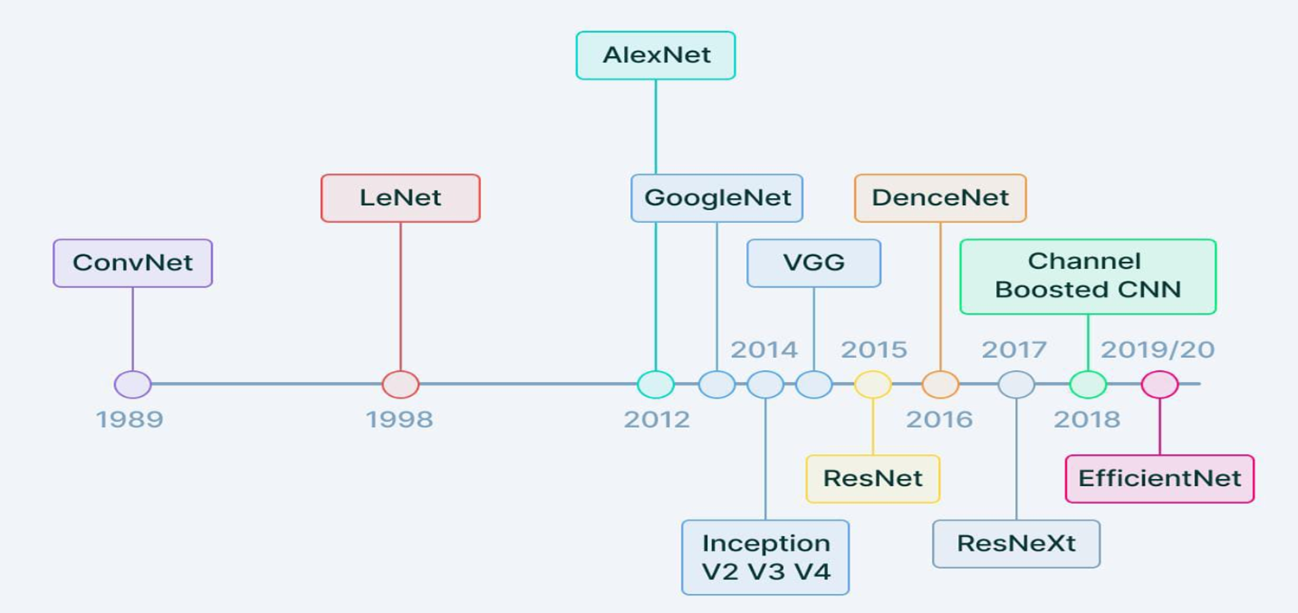
EVOLUTION OF CNN ARCHITECTURE

Slide 21


APPLICATIONS
FACIAL RECOGNITION MEDICAL IMAGING

Slide 22


APPLICATIONS
AUTONOMOUS DRIVING BIOMETRIC AUTHENTICATION

Slide 23

RECURRENT NEURAL NETWORKS
RNN

Slide 24
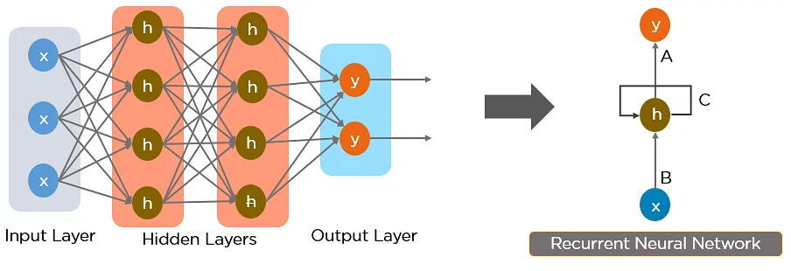
INTRODUCTION
Type of neural network → hidden states and allows past outputs to be used as inputs.
Modelling sequential data.
Generalize to variable-length sequences.

Slide 25
Why Recurrent Neural Networks?
RNN were created because there were a few issues in the feed-forward neural network:
Cannot handle sequential data
Considers only the current input
Cannot memorize previous inputs

Slide 26
WORKING OF RNN

Slide 27
Types of Recurrent Neural Networks
There are four types of Recurrent Neural Networks:
One to One
One to Many
Many to One
Many to Many

Slide 28
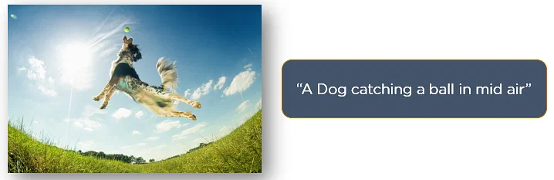
APPLICATIONS
IMAGE CAPTION GENERATOR

Slide 29

APPLICATIONS
NATURAL LANGUAGE PROCESSING

Slide 30
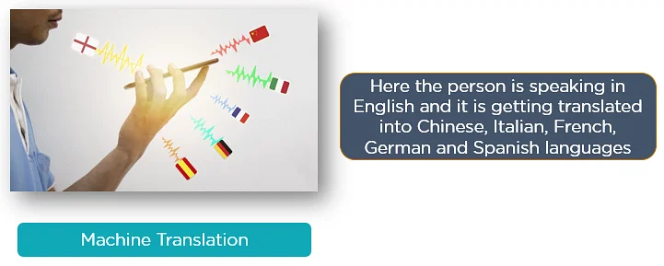
APPLICATIONS
MACHINE TRANSALATION

Slide 31
LONG SHORT TERM MEMORY
LSTM

Slide 32
INTRODUCTION
Type of RNNs Recurrent Neural Network.
Detain long-term dependencies in sequential data.
Able to process and analyze sequential data, such as time series, text, and speech.
Use a memory cell and gates to control the flow of information.

Slide 33
STRUCTURE OF LSTM
LSTM is a cell that consists of 3 gates:
Forget gate : responsible for deciding what information should be removed from the cell state
Input gate : input gate is used to update the cell state value
Output gate : returns the hidden state for the next time stamp.

Slide 34
WORKING OF LSTM
A cyclic set of steps happens in each LSTM cell
The Forget gate is computed.
The Input gate value is computed.
The Cell state is updated using the above two outputs.
The output(hidden state) is computed using the output gate.

Slide 35
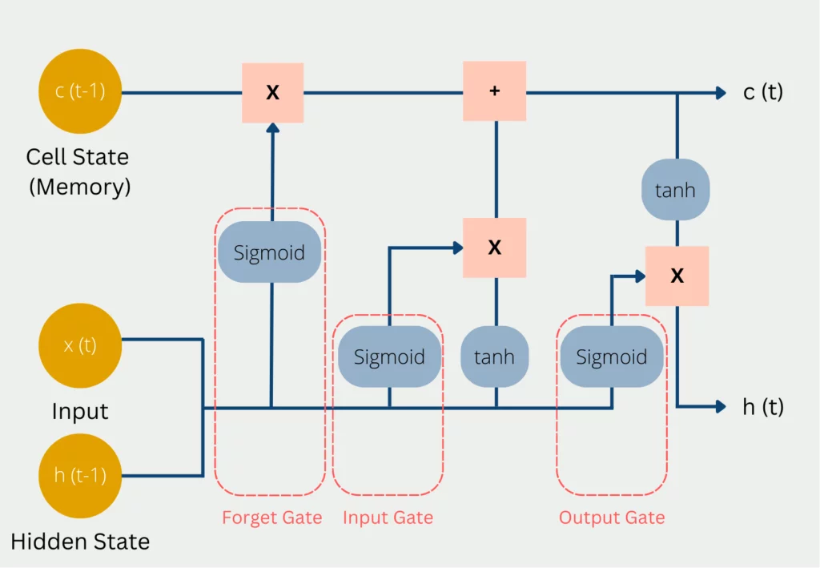

Slide 36
APPLICATIONS
Speech Recognition
Time series analysis
Music generation
Language modelling
Video analysis

Slide 37
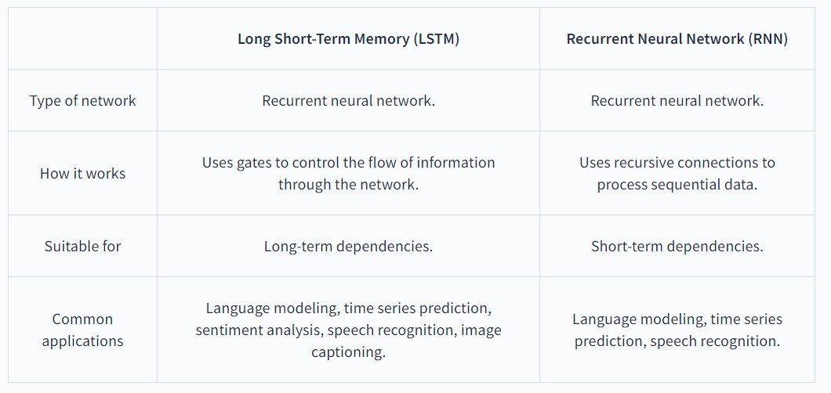
LSTM vs RNN

Slide 38
THANK YOU

